Slide 1

APEX INSTITUTE OF TECHNOLOGY
DEPARTMENT OF COMPUTER SCIENCE & ENGINEERING
Artificial Intelligence (22CST-347)
Faculty: Dr. Priyanka Kaushik
DISCOVER . LEARN . EMPOWER

Slide 2
Artificial Intelligence : Course Objectives
COURSE OBJECTIVES
(AI) is a research field that studies how to realize the intelligent human behaviors on a computer. The ultimate goal of AI is to make a computer that can learn, plan, and solve problems autonomously. Although AI has been studied for more than half a century, we still cannot make a computer that is as intelligent as a human in all aspects, The main research topics in AI include: problem solving, reasoning, planning, natural language understanding, computer vision, automatic programming, machine learning, and so on. Of course, these topics are closely related with each other. In this course, we will study the most fundamental knowledge for understanding AI. We will introduce some basic search algorithms for problem solving; knowledge representation and reasoning; pattern recognition; fuzzy logic; and neural networks

Slide 3
COURSE OUTCOMES
On completion of this course, the students shall be able to:-
CO4 | Co4 Design and evaluate intelligent expert models for perception and prediction from intelligent environment.
CO5 | CO5 Understanding and Implementation of Expert Systems and different Gaming playing approaches for different types of AI applications

Slide 4
Unit-3 Syllabus
Unit-3 |  | Contact Hours:15 hours
Ch1.Expert systems | Expert systems: - Introduction, structure of expert systems, Expert System Life Cycle, problem areas addressed by expert systems, Application of Expert, Knowledg Acquisition Types of expert systems.
Ch2.Game playing | Game playing Min-Max Search, Alpha-Beta Pruning,MonkeyBanana Problem,Water Jug Problem
Ch3. Application in Modern AI | Modern AI application, decision making , predictive analysis and adaptive analytics

Slide 5
SUGGESTIVE READINGS
TEXT BOOKS
T1. Artificial Intelligence: A Modern Approach by Stuart Russell and Peter Norvig. Prentice-Hall, 2003 (2ndEdition). T2. Elaine Riche, Kevin Knight and Shivashankar B. Nair, “Artificial Intelligence”, Third Edition, TMH Educations Pvt. Ltd., 2008
REFERENCE BOOKS
R1 Nils J. Nilsson, “The Quest for Artificial Intelligence”, Second Edition, Cambridge University Press, 2009
R2 Artificial Intelligence and Expert Systems – Dan W. Patterson, Prentice Hall of India

Slide 6
Expert System
Expert System Development Life Cycle:
A Knowledge Engineer or an AI Engineer is skilled in the art of developing Expert Systems (ES). A domain expert is an individual who has significant expertise in the domain of the expert system. It is not crucial that the domain expert understand AI or expert systems that is one of the functions of the knowledge engineer. The knowledge engineer and the domain expert usually work close to each other throughout the Expert System Development Life Cycle process.

Slide 7
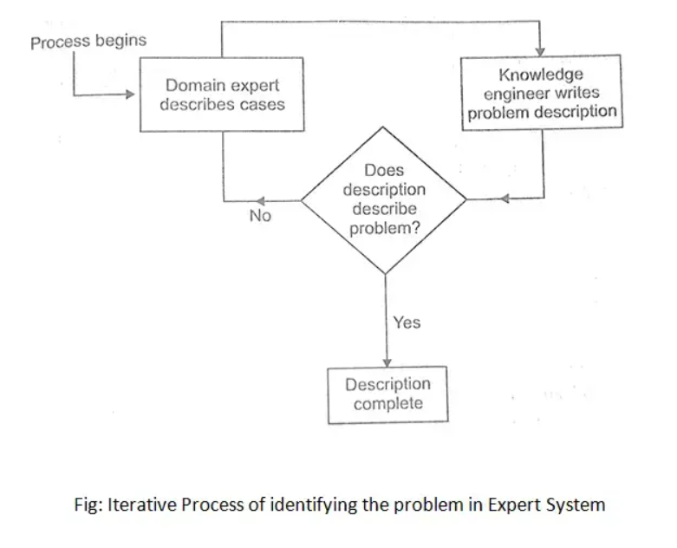
Steps to Develop an Expert System:
Steps to Develop an Expert System:
An expert system (ES) was developed and refined over several years. Expert System Life Cycle has five stages –
Step1: Identification: Determining the characteristics of the problem.

Slide 8
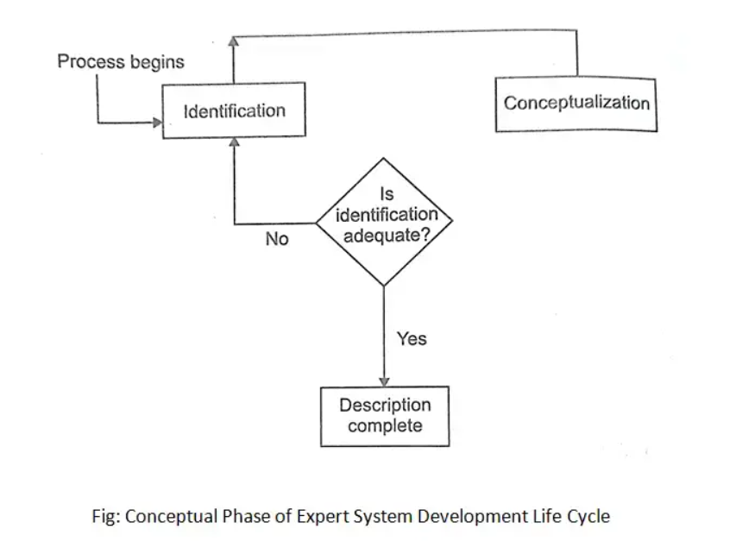
PHASE
Step2: Conceptualization: Finding the concept to produce the solution.

Slide 9
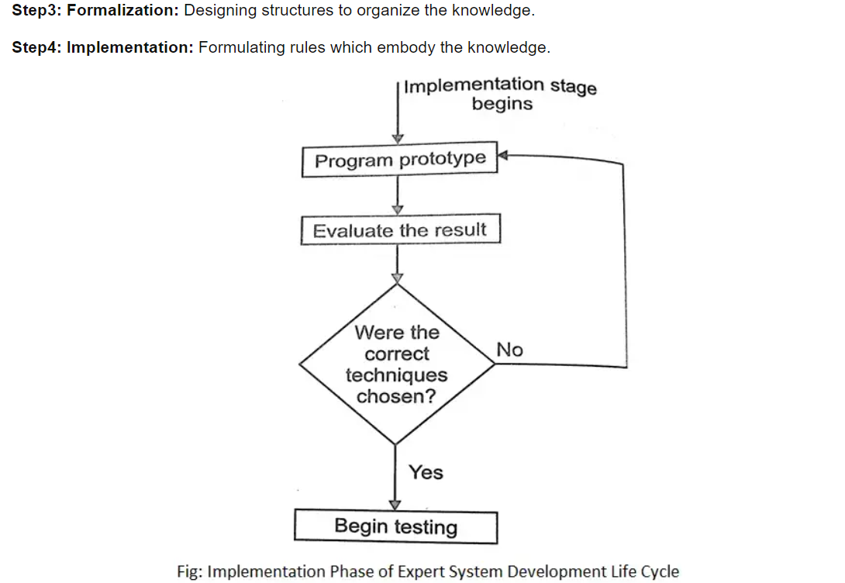
PHASE

Slide 10
PHASE
Step5: Testing: Validating the rules.
The chances of a prototype expert system executing flawlessly are very less initially. A knowledge engineer doesn’t expect the testing process to verify that the system has been constructed entirely correctly. Testing provides an opportunity to identify the weaknesses in the structure and the implementation of the system.

Slide 11

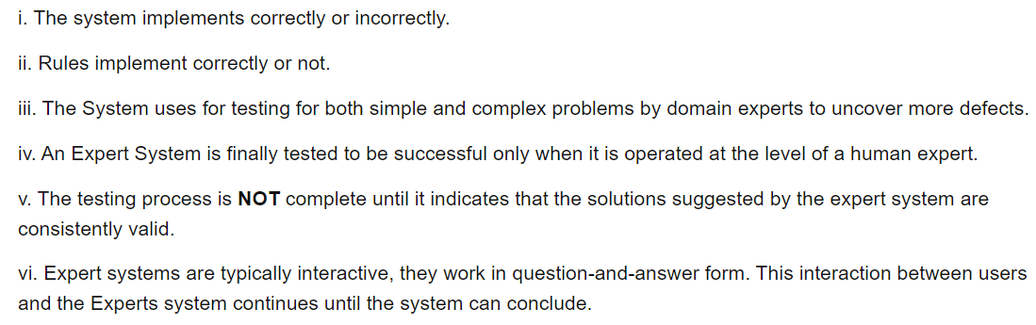
PHASE

Slide 12
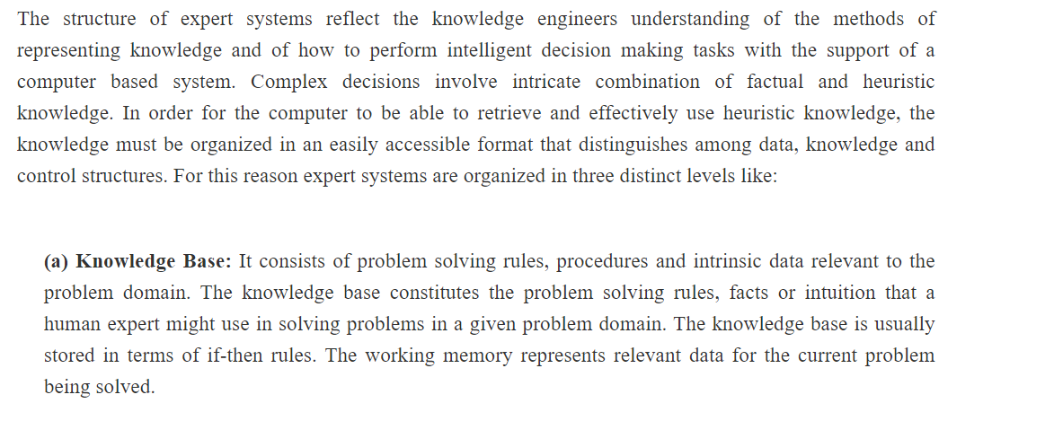
STRUCTURE OF AN EXPERT SYSTEM

Slide 13
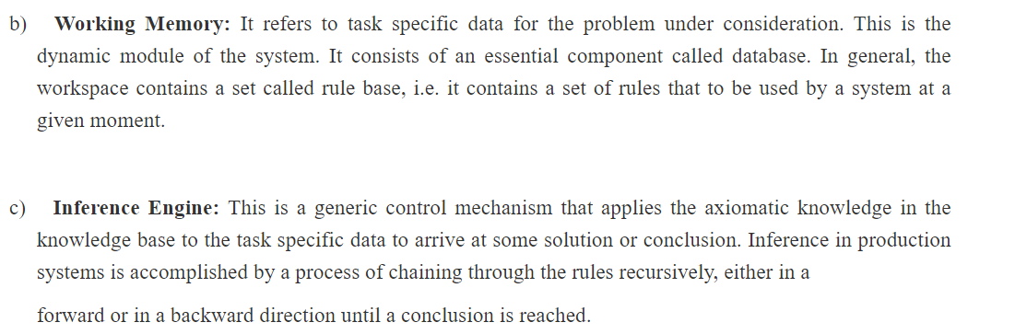
STRUCTURE OF AN EXPERT SYSTEM

Slide 14
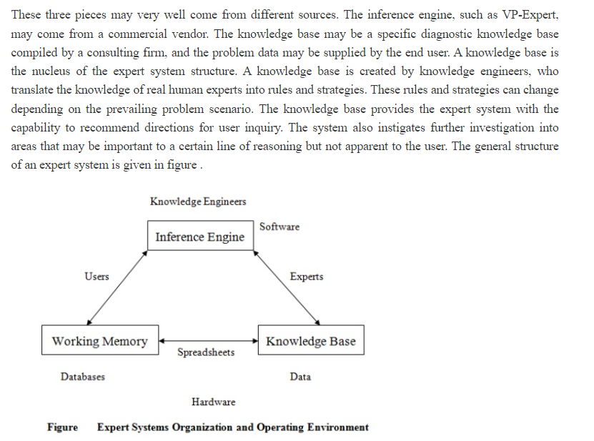
STRUCTURE OF AN EXPERT SYSTEM

Slide 15
problem areas are addressed by expert systems
problem areas are addressed by expert systems
It is used in various medical diagnoses, accounting, coding, gaming, and more areas. Breaking down an expert system essentially is AI software that uses knowledge stored in a knowledge base to solve problems. This usually requires a human expert; thus, it aims at preserving human expert knowledge in its knowledge base.

Slide 16
REFERENCES
Artificial Intelligence: A Modern Approach by Stuart Russell and Peter Norvig. Prentice-Hall, 2003 (2nd Edition).

Slide 17
THANK YOU

